Slide 1
Improving Forecast Guidance through the Joint Hurricane Testbed
Brian Zachry – NOAA/NWS/NCEP/National Hurricane Center
Jason Sippel – NOAA/OAR/AOML Hurricane Research Division
The JHT is funded by the US Weather Research Program in
NOAA/OAR’s Weather Program Office
101st AMS Annual Meeting

Slide 2
Joint Hurricane Testbed (JHT)
Bridges gap between hurricane research & operations
Began in 2001 under the USWRP
Currently in 10th round of projects
Our Mission: successfully transfer new technology, research results & observational advances from research groups to operational centers
Testing is primary done at the National Hurricane Center, Central Pacific Hurricane Center, or Joint Typhoon Warning Center
Notes:
17 yrs
> Bridge research and operations (tail end of RL)
> operational centers (NHC/EMC/CPHC, sometimes Navy)
> JHT is funded by USWRP Office Weather and Air Quality

Slide 3
JHT Staff and Funding
Brian Zachry: JHT Director, NHC Science and Operations Officer, and Transition POC
Jason Sippel: JHT Assistant Director and HRD Meteorologist
Alan Brammer: JHT R2O Facilitator/Programmer
Current Funding:
Roughly 600K for current projects
½ time support for JHT Facilitator/Programmer
0.2 FTE support and HRD for admin support
15K for JTTI project support (real-time demonstration and evaluation)

Slide 4
JHT Project Overview
Round 8 (FY15-17): 8 projects completed
5 accepted for operational implementation
1 deferred until additional evaluation can be conducted
2 not accepted for operational implementation
Round 9 (FY17-19): 6 projects in total
1 projects in no-cost extension
5 project completed (awaiting decision letters)
Round 10 (FY19-22): 3 new projects in progress
Notes:
17 yrs
> Bridge research and operations (tail end of RL)
> operational centers (NHC/EMC/CPHC, sometimes Navy)
> JHT is funded by USWRP Office Weather and Air Quality

Slide 5
Metrics for Operational Implementation
Forecast or Analysis Benefit: expected improvement operational forecasts and/or analysis benefit
Efficiency: adherence to forecaster time constraints and ease of user’s needs
Compatibility: IT compatibility with operational hardware, software, data, communication, etc.
Sustainability: availability of resources to operate, upgrade, and/or provide support
Notes:
What does it take to get a project into operational implementation?

Slide 6
NHC Procedure for Operational Decision
JHT staff receive final project reports from PI(s)
Distribute interim and final project reports to NHC forecaster points of contact (POCs), TSB Chief, HSU Chief, and JHT Director for comments and feedback
Collect feedback from project POCs from real-time demonstrations
Author official NHC recommendation letters for each project
Brief NHC Director on each project and JHT staff recommendation
NHC Director makes final decision and signs recommendation letter
Send final decision letters to PI(s)
NHC/TSB adds JHT transitions to annual development priorities

Slide 7
JHT Operational Implementation Summary
98 projects supported in 10 funding rounds
59 accepted for operational implementation
24 not accepted
6 deferred
3 projects ongoing, 1 project in NCE, and 5 require decision letters
FY15-17 Projects Accepted for NHC Operational Implementation
Project Title | Principal Investigator(s)
Improvements in Operational Statistical Tropical Cyclone Intensity Forecast Models | Galina Chirokova and Andrea Schumacher (CSU/CIRA)
Transition of the Coastal and Estuarine Storm Tide Model to an Operational Model for Forecasting Storm Surges | Keqi Zhang (FIU)
Improvements to the Tropical Cyclone Genesis Index (TCGI) | Jason Dunion (U of Miami/CIMAS/AOML), Andrea Schumacher (CSU/CIRA), John Kaplan (NOAA/AOML), and Josh Cossuth (NRL)
Guidance on Observational Undersampling over the Tropical Cyclone Lifecycle | Dave Nolan (U of Miami/RSMAS) and Brad Klotz (U of Miami/CIMAS/AOML)
Passive Microwave Data Exploitation via the NRL Tropical Cyclone Webpage | Richard Bankert (NRL), Tom Birchard (CPHC), Josh Cossuth(NRL), and Kim Richardson (NRL)

Slide 8
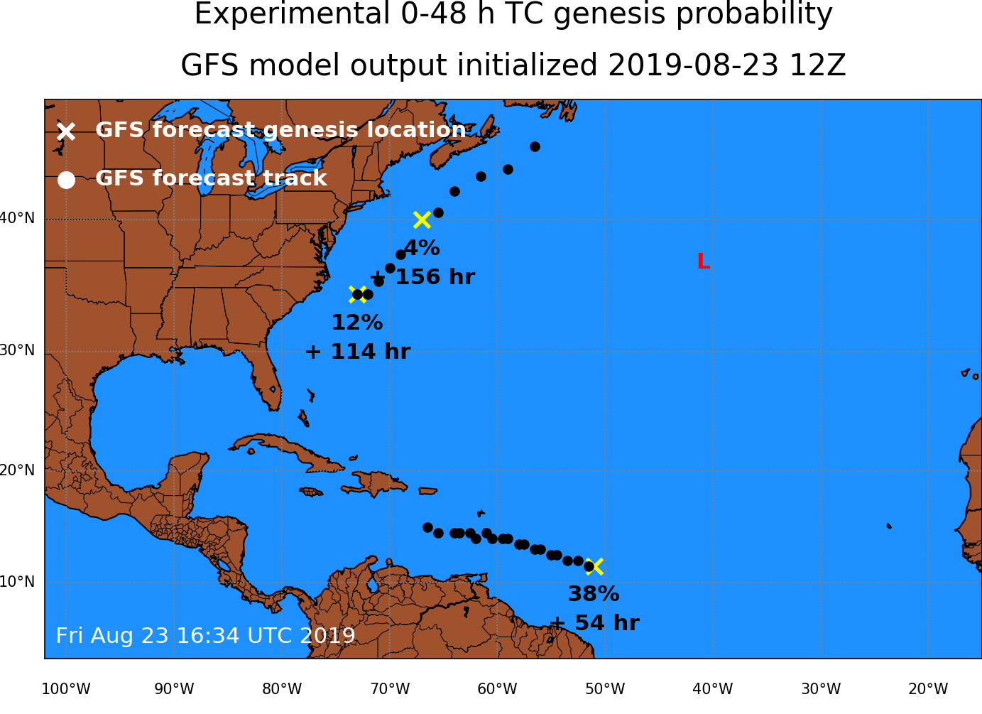
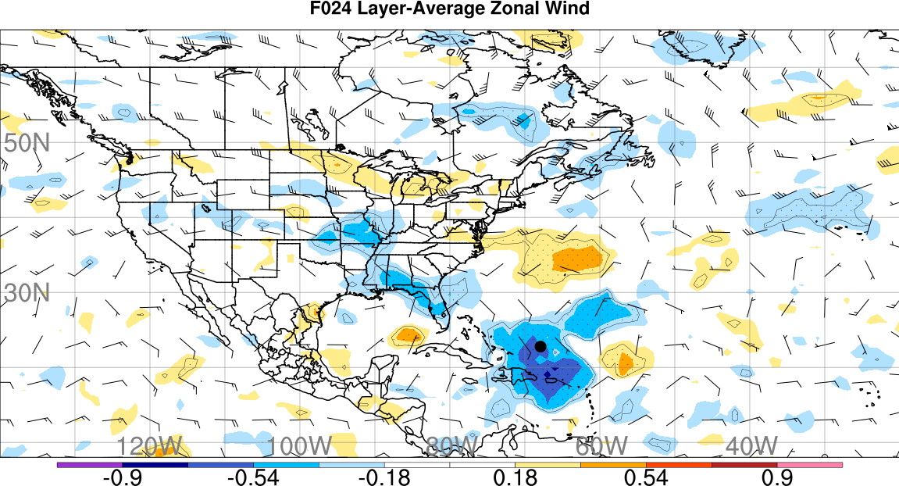
New FY19-22 Projects
Project Title (FY19-22) | Principal Investigator(s)
Further improvements and extensions to the tropical cyclone logistical guidance for genesis (TCLOGG) | Robert Hart (FSU) Dan Halperin (Embry-Riddle)
Upgrades to the M-PERC and PERC Models to Improve Short Term Tropical Cyclone Intensity Forecasts | Derrick Herndon (UW Madison)
Transitioning Ensemble-based TC Track and Intensity Sensitivity to Operations | Ryan Torn (Albany)

Slide 9
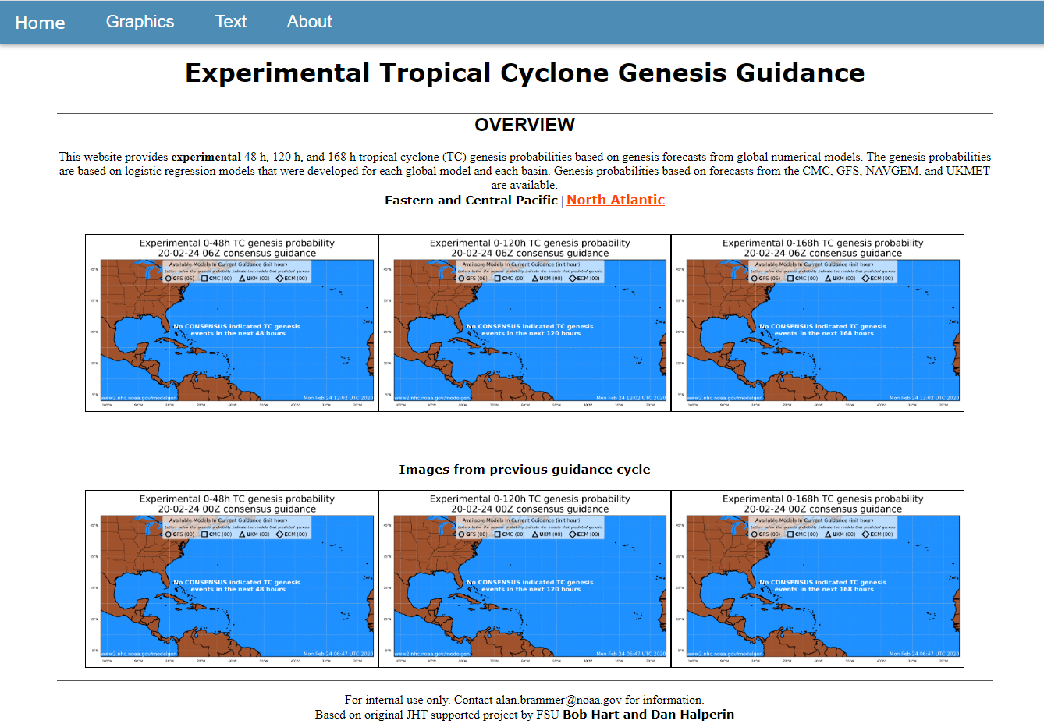
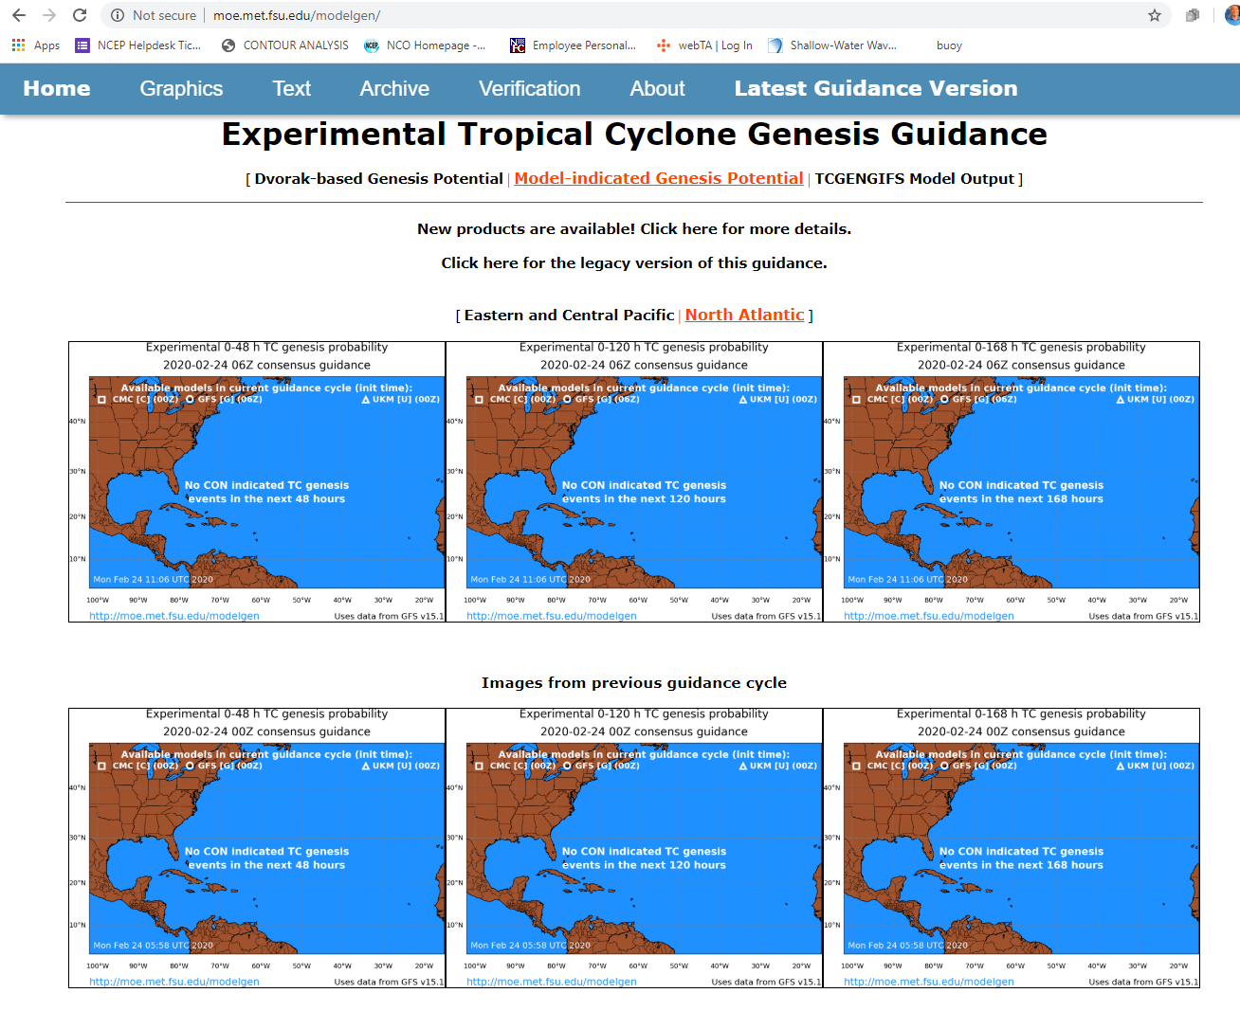
TCLOGG (Hart & Halperin)
NHC Internal Webpage
FSU Webpage

Slide 10
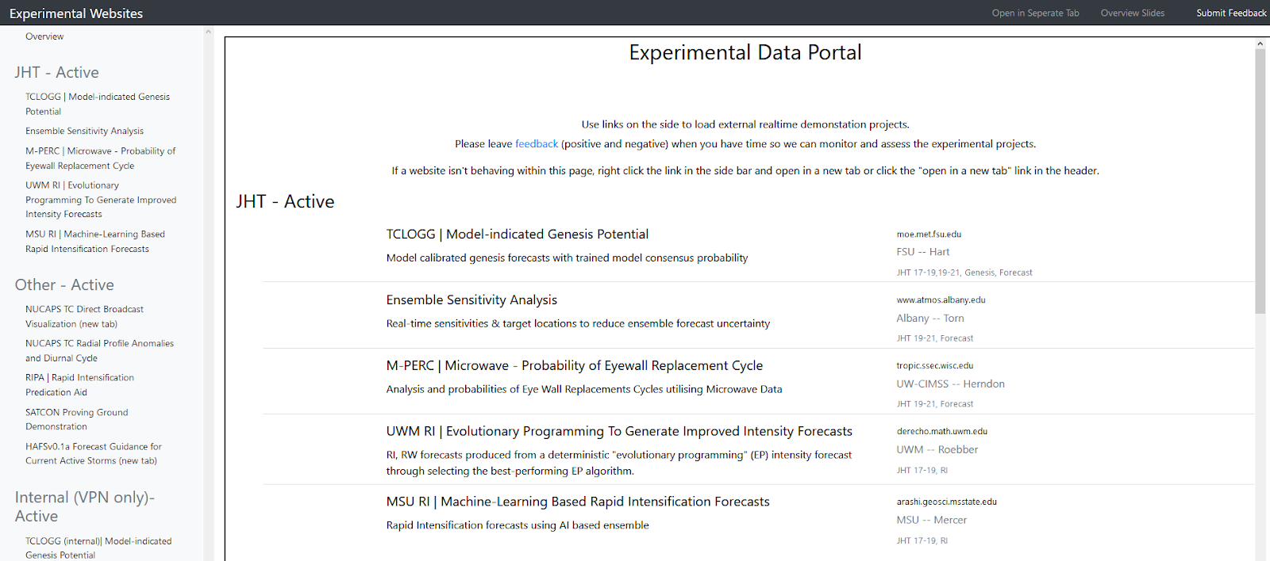
Real-Time Demonstrations and Webpage

Slide 11
Testbed Expansion at NHC
NHC has intentions to expand the scope of the testbed in the future to support evaluation and testing of other R2O initiatives/testbeds
Testbed will allow for real-time demonstrations and evaluation by NHC forecaster points of contact, including formal NHC decision letter
Testbed for JTTI, HFIP, and other projects
Mimic operations and data ingest by providing a parallel AWIPS system for demonstrations
NHC/TSB adds project transitions to annual development priorities
Many organizations have shown interest in participating and expanding the testbed further (e.g., social science, satellite, etc.)
Currently have ~90K in funding for NHC library renovation, office furniture, laptops, Linux workstations, A/V equipment, etc.

Slide 12
Improving Forecast Guidance through the Joint Hurricane Testbed
Brian Zachry – NOAA/NWS/NCEP/National Hurricane Center
Jason Sippel – NOAA/OAR/AOML Hurricane Research Division
The JHT is funded by the US Weather Research Program in
NOAA/OAR’s Weather Program Office
101st AMS Annual Meeting

