Slide 1
Tropical Cyclone Forecast Products from the National Hurricane Center
Brad Reinhart
NHC Hurricane Specialist

Slide 2
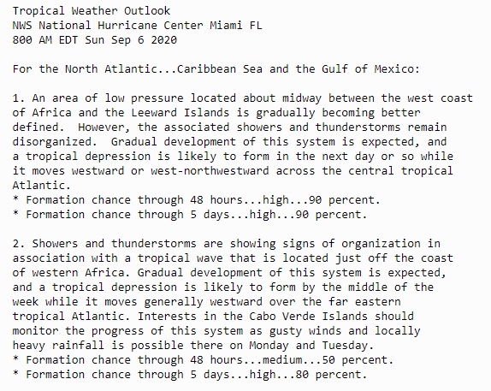
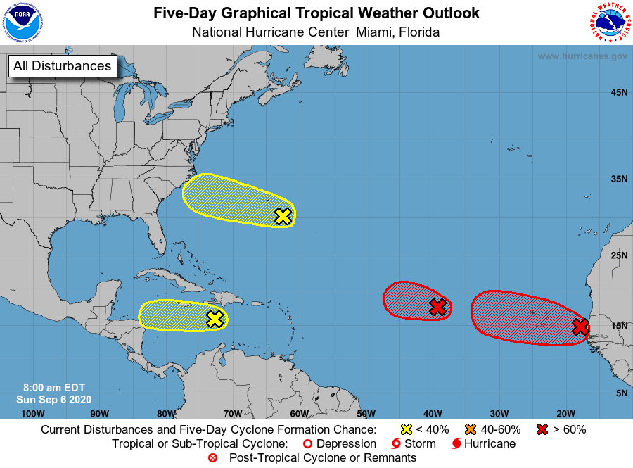
Tropical Cyclone Products
Tropical Weather Outlook
Discusses significant areas of disturbed weather and their tropical cyclone development potential during the next 5 days
Issued every six hours from 15 May – 30 November

Slide 3
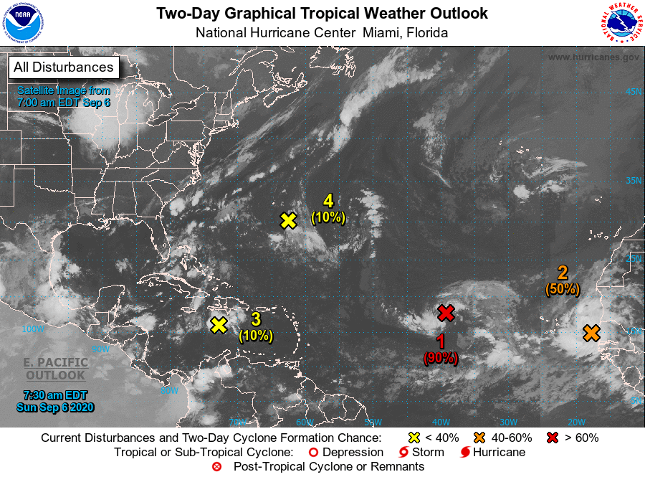
Tropical Weather Outlook
Two-Day Graphic
Initial location of each disturbance in the Tropical Weather Outlook (X)
Categorical formation chance of each disturbance during the next 48 h with probabilities
Low: 0-30%
Medium: 40-60%
High: 70-100%
2. Showers and thunderstorms are showing signs of organization in association with a tropical wave that is located just off the coast of western Africa. Gradual development of this system is expected, and a tropical depression is likely to form by the middle of the week while it moves generally westward over the far eastern tropical Atlantic. Interests in the Cabo Verde Islands should monitor the progress of this system as gusty winds and locally heavy rainfall is possible there on Monday and Tuesday.
* Formation chance through 48 hours...medium...50 percent.
* Formation chance through 5 days...high...80 percent.

Slide 4
Tropical Weather Outlook
Five-Day Graphic
Initial location of each disturbance (X)
Categorical formation potential (low, medium, & high) during the next 5 days
The shading represents a potential formation area – not a 5-day track forecast!

Slide 5
Once a tropical cyclone forms… What NHC products are created?

Slide 6
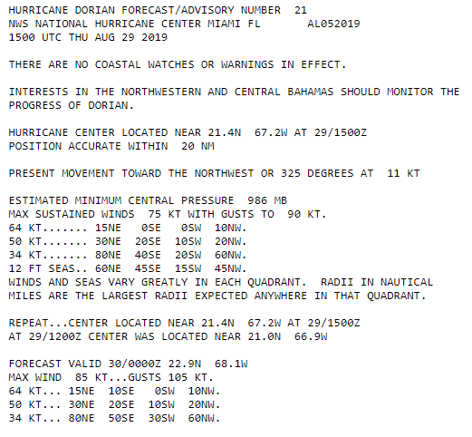
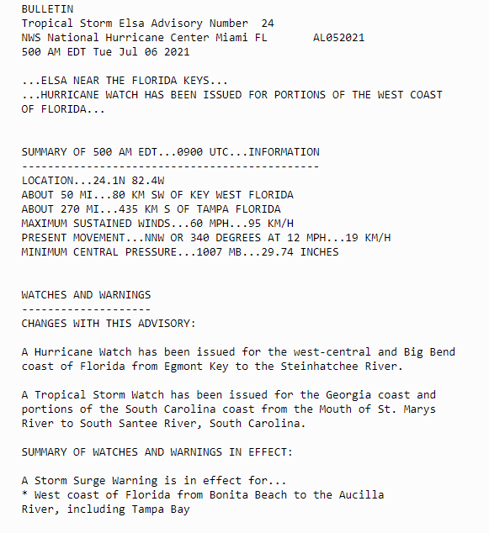
Tropical Cyclone Text Products
Forecast & Public Advisory
Tropical Cyclone Forecast/Advisory (TCM)
Tropical Cyclone Public Advisory (TCP)

Slide 7
Tropical Cyclone Text Products Forecast Discussion
HURRICANE JOAQUIN DISCUSSION NUMBER 15
NWS NATIONAL HURRICANE CENTER MIAMI FL AL112015
1100 AM EDT THU OCT 01 2015
An Air Force Reserve Hurricane Hunter aircraft reported 700-mb flight-level winds of 119 kt in the northwestern eyewall, with a 117 kt surface wind estimate from the Stepped Frequency Microwave Radiometer in the southwestern eyewall. The latest central pressure was 942 mb. Based on these data, the advisory intensity is increased to 110 kt. Satellite imagery indicates that an eye is trying to form in the central dense overcast, and that the cirrus outflow is good in all directions. Joaquin is expected to intensify a little more in the next 12 to 24 hours as it remains over very warm waters and in an environment of decreasing vertical shear. After that time, there could be some fluctuations in intensity due to eyewall replacement cycles. There is some uncertainty in the intensity forecast in the 48-96 hour period. The statistical models suggest that Joaquin should weaken due to increasing shear. However, several of the global models forecast the hurricane to move into an area of strong upper-level divergence and show a falling central pressure. The new forecast will continue to show weakening during this time, but it would not be a surprise if it is stronger than currently forecast. The initial motion is 220/5. Water vapor imagery shows a mid- to upper-level ridge north of the hurricane, with a developing deep-layer trough over the eastern and southeastern United States. The dynamical models forecast this trough to become a cut-off low as it moves southeastward and weakens the ridge. This pattern evolution should cause Joaquin to turn northwestward in 24 hours or so and then turn northward. After 36 hours, the guidance remains very divergent. The Canadian, GFDL, HWRF, and NAVGEM models forecast Joaquin to turn northwestward and make landfall over the Carolinas and mid-Atlantic States. The ECMWF continues to forecast a slower northeastward motion taking Joaquin near Bermuda and out to sea. The UKMET and GFS are in between these extremes showing a generally northward motion. Given the spread and the possibility that the 1200 UTC guidance could show additional changes, the forecast track after 36 hours is nudged only slightly to the east at this time. The new track lies to the east of the landfalling models, but to the west of the GFS, UKMET, ECMWF, and the various consensus models. Further adjustments to the track may be needed later today depending on how the models do (or do not) change.
KEY MESSAGES:
1. Preparations to protect life and property in the central Bahamas should be complete. The slow motion of Joaquin over the next day or so will bring a prolonged period of hurricane force winds, storm surge, and very heavy rainfall to those islands.
2. Confidence in the details of the forecast after 72 hours is still low, since there have been some large changes in the model guidance overnight and a large spread in the model solutions remains, with potential impacts from the Carolinas through New England. It is also possible that Joaquin will remain far from the U.S. east coast. A hurricane watch for the U.S. coast would likely not occur until at least Friday morning.
3. Efforts to provide the forecast models with as much data as possible continue, with twice daily NOAA G-IV jet missions in the storm environment, and extra NWS balloon launches.
4. It's too early to talk about specific wind, rain, or surge impacts from Joaquin in the United States. Regardless of Joaquin's track, strong onshore winds will create minor to moderate coastal flooding along the coasts of the mid-Atlantic and northeastern states through the weekend.
5. Many portions of the eastern U.S. are currently experiencing heavy rains and gusty winds associated with a frontal system. These heavy rains are likely to continue for the next few days, even if the center of Joaquin stays offshore. The resulting inland flood potential could complicate preparations for Joaquin should it head toward the coast, and even more substantial inland flooding is possible if Joaquin later passes near or over these same areas.
FORECAST POSITIONS AND MAX WINDS
INIT 01/1500Z 23.0N 73.9W 110 KT 125 MPH
12H 02/0000Z 22.9N 74.2W 115 KT 130 MPH
24H 02/1200Z 23.7N 74.6W 120 KT 140 MPH
36H 03/0000Z 25.2N 74.4W 120 KT 140 MPH
48H 03/1200Z 27.5N 73.7W 110 KT 125 MPH
72H 04/1200Z 32.0N 73.0W 95 KT 110 MPH
96H 05/1200Z 36.0N 73.5W 75 KT 85 MPH
120H 06/1200Z 40.0N 72.5W 55 KT 65 MPH
$$
Forecaster Beven
Relevant data & observations
Forecast reasoning & uncertainty
Model guidance analysis

Slide 8
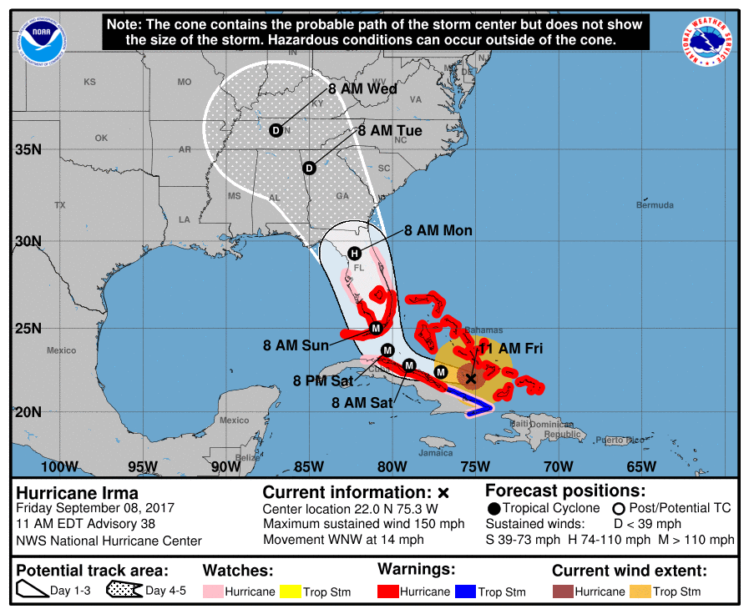
Tropical Cyclone Products Cone Graphic
Probable track of the tropical cyclone center Formed by connecting circles centered on each forecast point
Each circle uses NHC historical track errors Actual storm position will be within the circle 2/3 (67%) of the time.

Slide 9
Tropical Cyclone Products Cone Graphic
Cone only displays information about track uncertainty
No information about specific impacts or hazards
No information about storm size
Impacts will occur well outside the area enclosed by the cone
Center is expected to move outside the cone about 1/3 of the time
Hurricane Irma
5 am Sunday, September 10

Slide 10
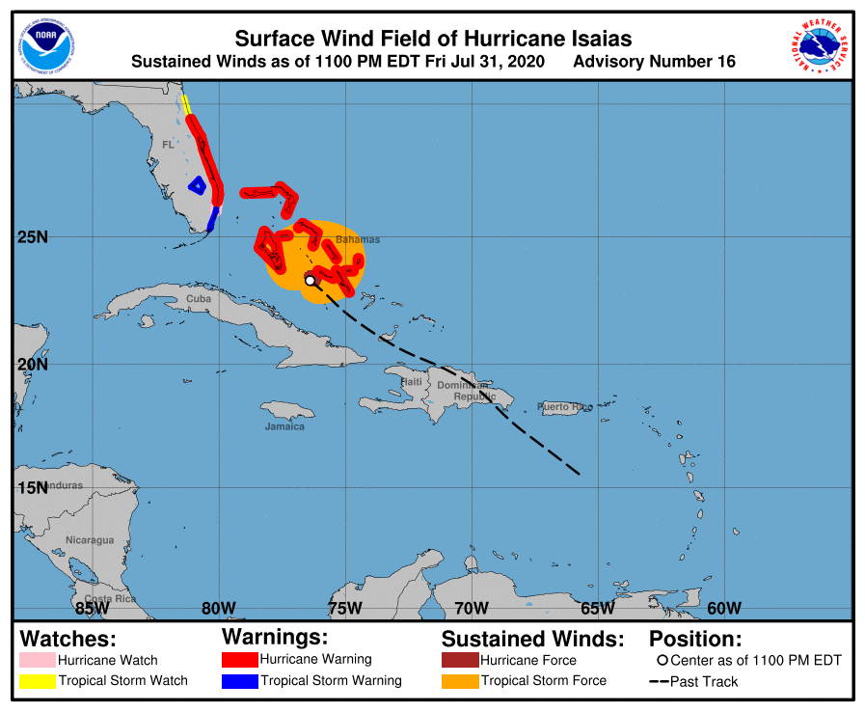
Tropical Cyclone Products Surface Wind Field Graphic
Radii represent the largest distance from the center in each quadrant
MAX SUSTAINED WINDS 70 KT WITH GUSTS TO 85 KT. 64 KT....... 30NE 20SE 0SW 20NW. 50 KT....... 80NE 30SE 0SW 50NW. 34 KT.......150NE 70SE 30SW 130NW.

Slide 11
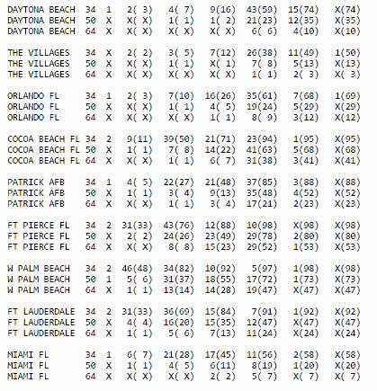
Tropical Cyclone Products Wind Speed Probabilities
Location-specific probabilities
34 kt (Tropical-storm-force)
50 kt (58 mph)
64 kt (Hurricane-force)
Text product (fixed set of locations)
Onset probabilities
Cumulative probabilities
Graphical product
Cumulative probabilities for locations over a large domain

Slide 12
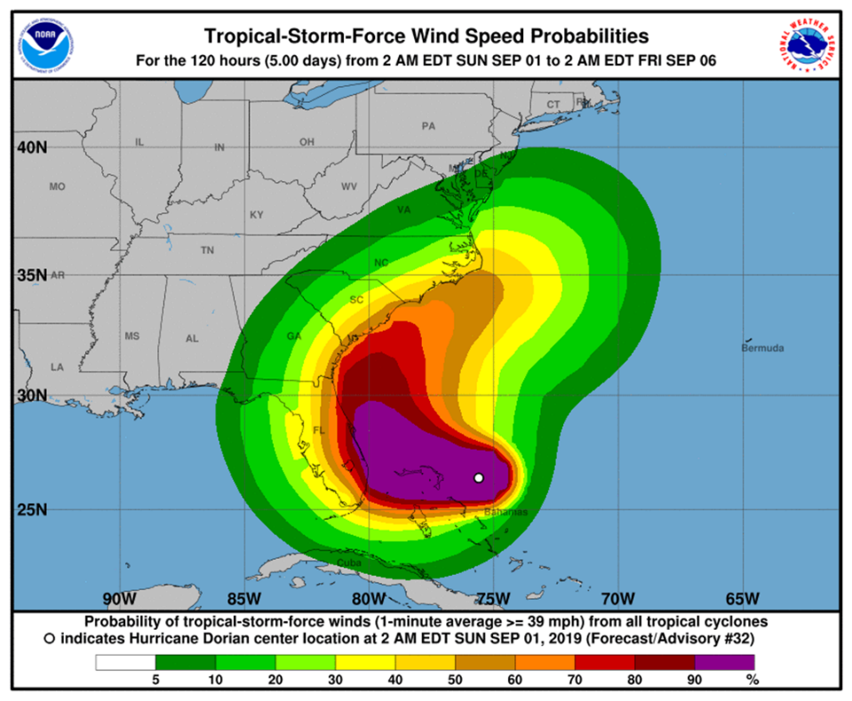
Tropical Cyclone Products Wind Speed Probabilities
Location-specific probabilities
34 kt (Tropical-storm-force)
50 kt (58 mph)
64 kt (Hurricane-force)
Text product (fixed set of locations)
Onset probabilities
Cumulative probabilities
Graphical product
Cumulative probabilities for locations over a large domain

Slide 13
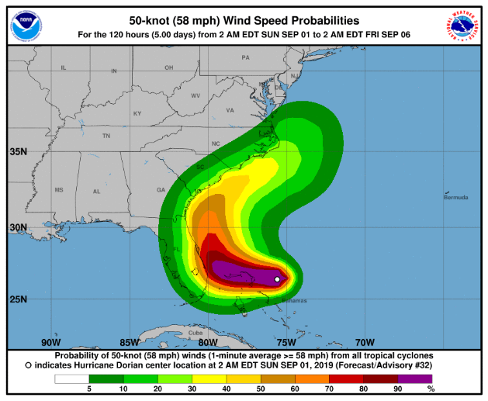
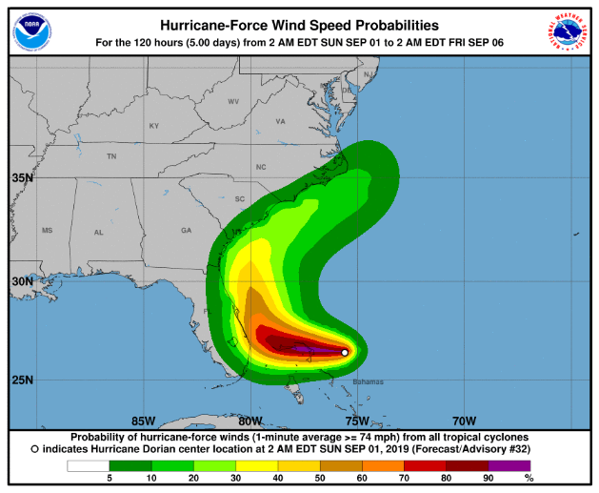
Tropical Cyclone Products Wind Speed Probabilities
34 kt
50 kt
64 kt

Slide 14
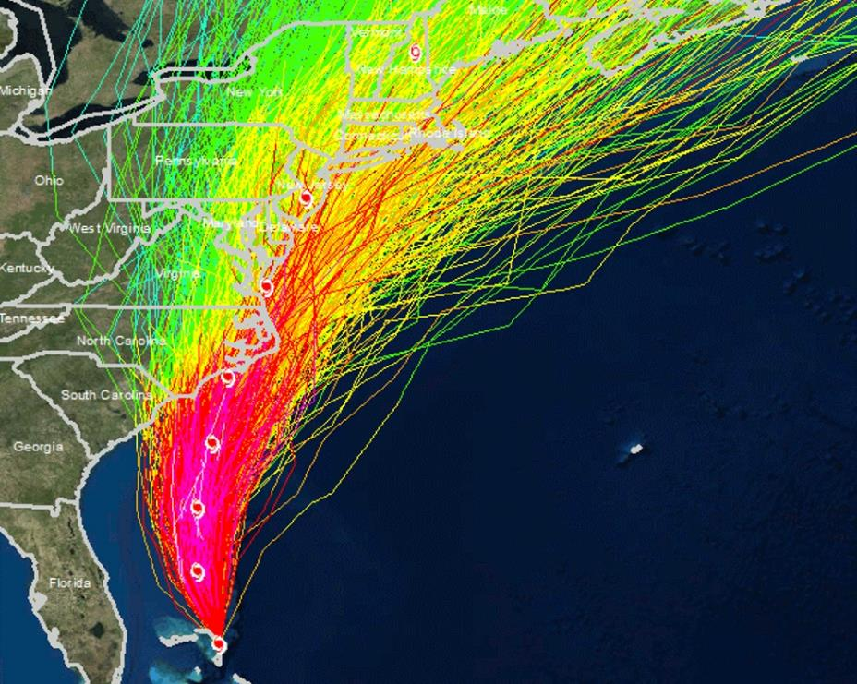
Wind Speed Probabilities
How are they generated?
1,000 realistic alternative scenarios are created
Official NHC forecast
Historical NHC track and intensity forecast errors
Climatology and persistence wind radii model
Track model spread
Past NHC track forecast errors are correlated to the spread of track model guidance
Weakening over land
59%
New York City, NY
590 of 1,000 scenarios produce tropical-storm-force winds at that location.
590/1,000 = 59% chance of TS-force winds

Slide 15
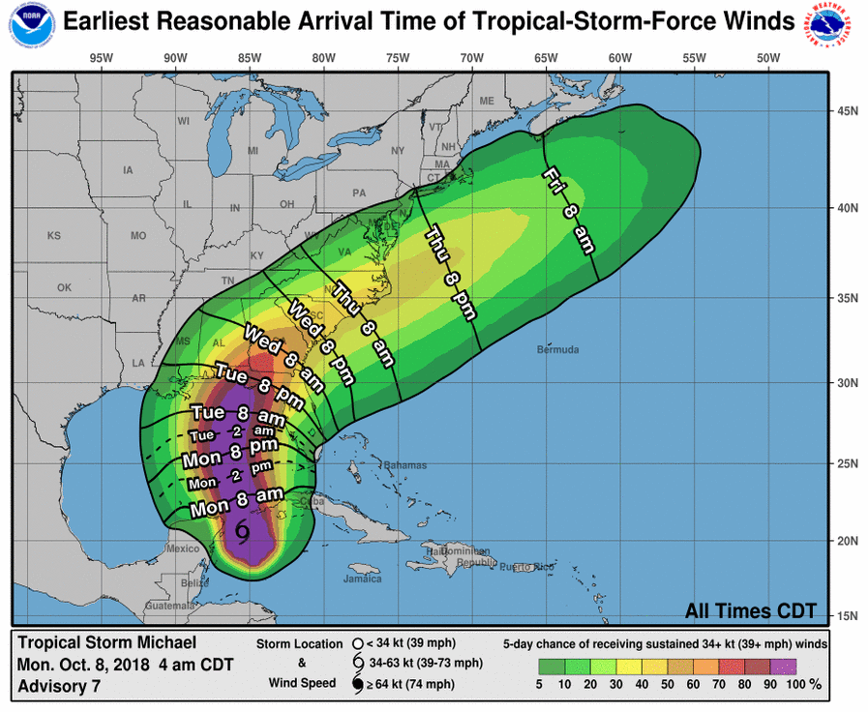
Tropical Cyclone Products Time of Arrival Graphics
Shows earliest reasonable arrival time of TS winds (black contours) and cumulative TS wind speed probabilities (colors)
Identifies the time window that users at individual locations can safely assume will be free from TS winds
Best for users with low tolerance for risk
Earliest Reasonable Arrival of TS-Force Winds

Slide 16
Tropical Cyclone Products Time of Arrival Graphics
Shows most likely arrival time of TS winds (black contours) and cumulative TS wind speed probabilities (colors)
Shows the time before or after which the onset of sustained TS winds is equally likely
Best for users that are willing to risk not having completed preparations before TS winds arrive
Most Likely Arrival of TS-Force Winds

Slide 17
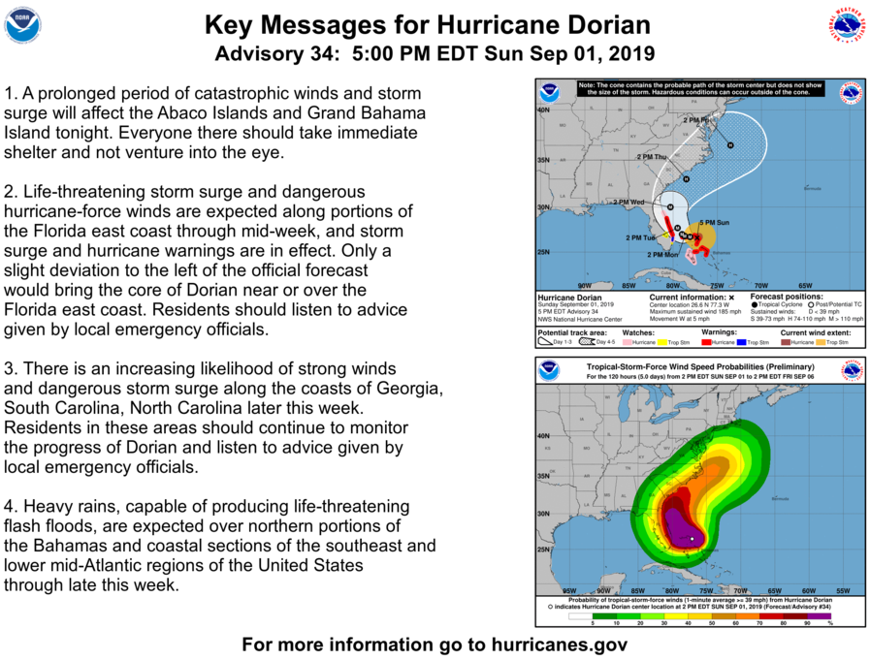
Tropical Cyclone Products Key Messages
Highlight essential points about hazards and forecast uncertainty for select tropical cyclones
Available on the NHC website and shared on NHC social media pages during events

Slide 18
Watches & Warnings
Hurricane Watch
Hurricane conditions are possible somewhere within the watch area, generally within 48 hours
Hurricane Warning
Hurricane conditions are expected somewhere within the warning area, generally within 36 hours
Note: The lead time for Hurricane Watches and Warnings is tied to the anticipated arrival time of tropical-storm-force winds.

Slide 19
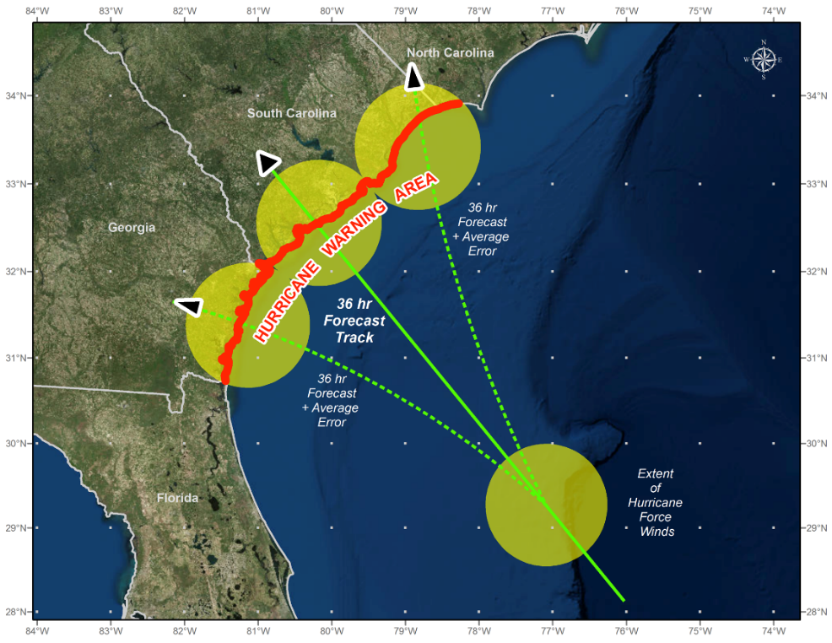
Watches & Warnings
Warning Considerations:
- Forecast track - Storm size - Coastline orientation - Known uncertainties
Watches & warnings are a risk communication tool, not an explicit forecast!
(AVERAGE 36-HOUR FORECAST ERROR IS ABOUT ~ 60 MILES)

Slide 20
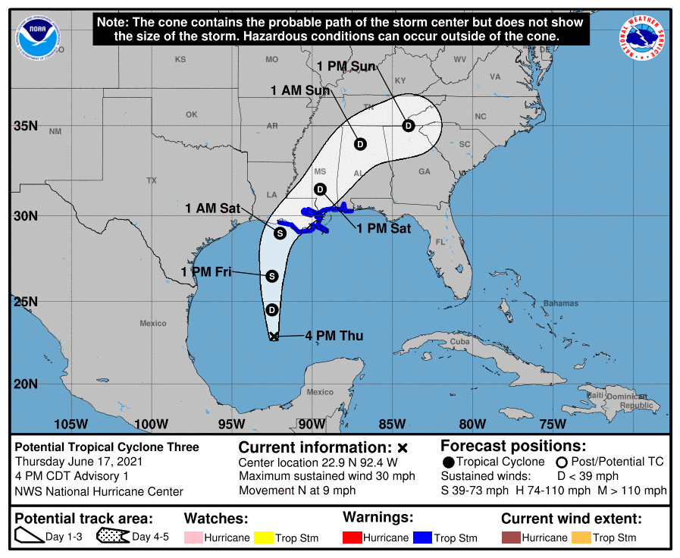
Potential Tropical Cyclone Advisories
Standard suite of NHC text and graphical products that are produced before a tropical cyclone forms
PTC advisories are only issued for systems threatening land within the watch/warning time frame
Enable us to issue tropical watches & warnings with sufficient lead time for developing systems
Watch: 48 h before arrival of TS-force winds
Warning: 36 h before arrival of TS-force winds

Slide 21
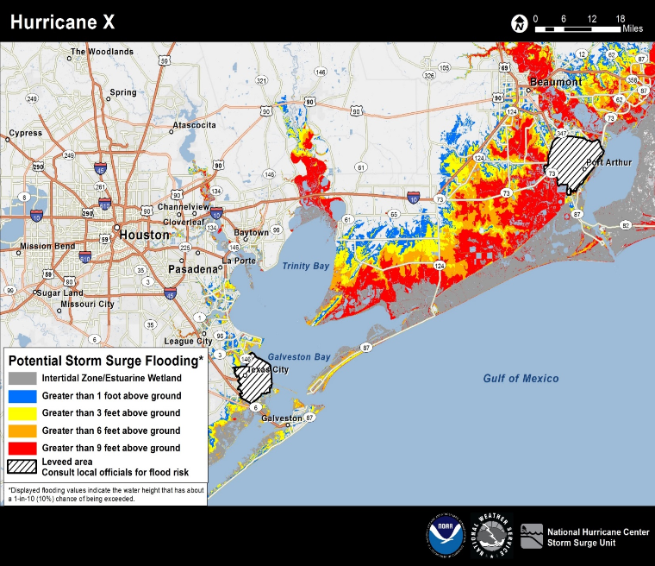
Storm Surge Products
Potential Storm Surge Flooding Map
Depicts height above ground that the water could reach (reasonable worst-case scenario) at any individual location.
Provides a quantitative risk assessment for decision makers.
First map issued at the same time as the initial hurricane watch or in some cases, with a tropical storm watch.
Available about 60 to 90 minutes following the advisory release.

Slide 22
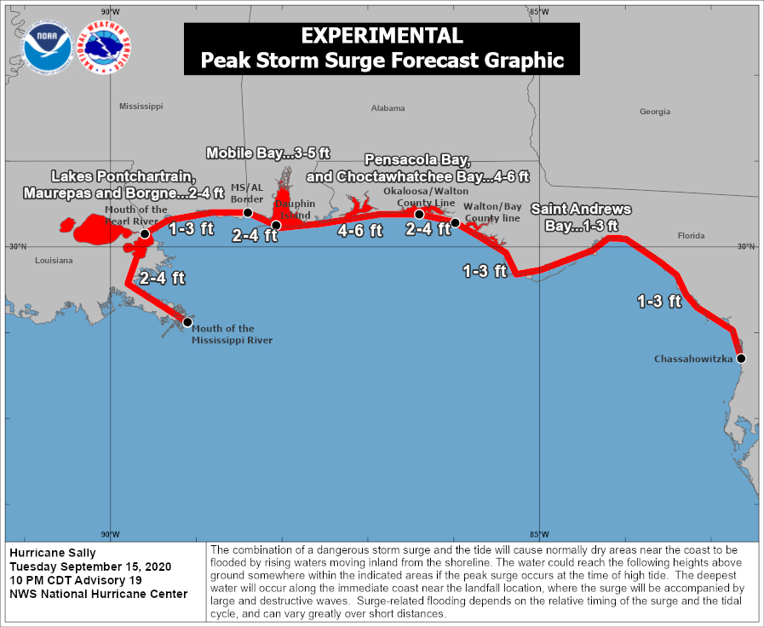
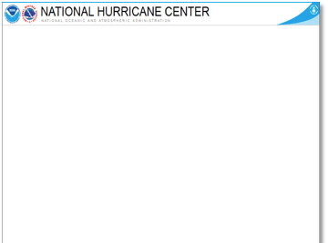
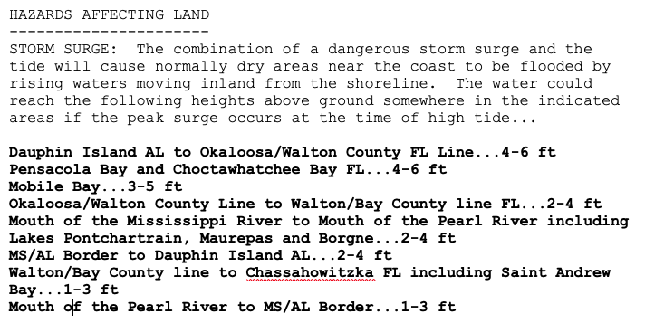
Storm Surge Products
Peak Inundation Graphic
Peak storm surge inundation expected to occur somewhere within the outlined area
Reflects the storm surge values that are included with the public advisory
Not location-specific
Differs from Potential Storm Flooding map

Slide 23
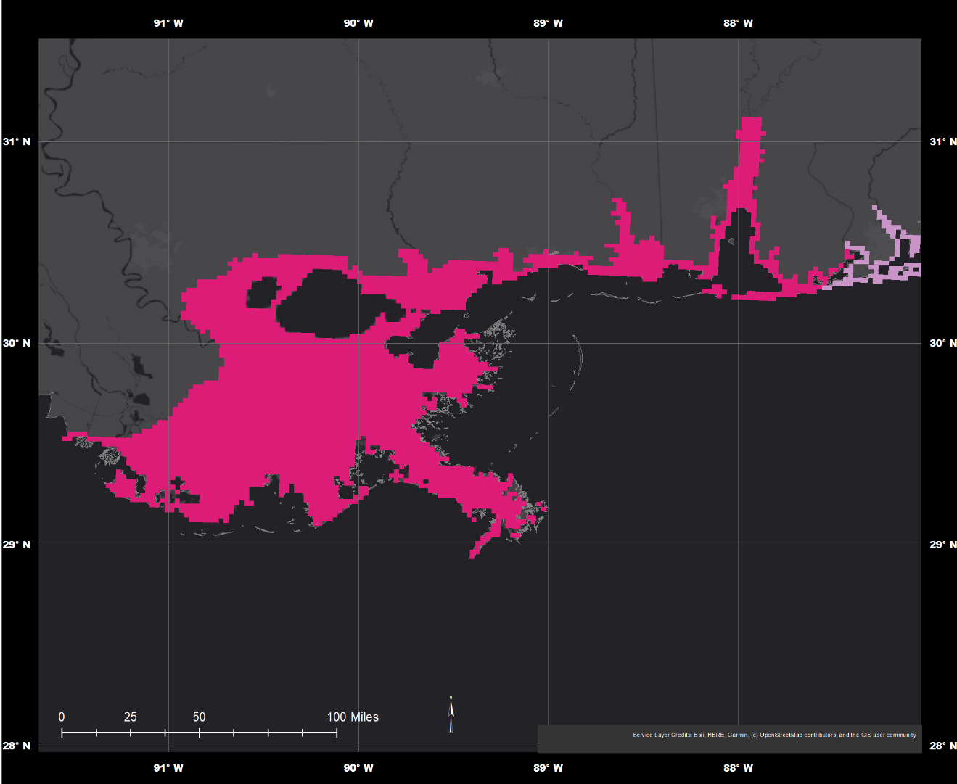
Storm Surge Products
Watch/Warning Graphic
Storm Surge Warning: The danger of life-threatening inundation from rising water moving inland from the shoreline somewhere within the specified area, generally within 36 h.
Storm Surge Watch: The possibility of life-threatening inundation from rising water moving inland somewhere within the specified area, generally within 48 h.

Slide 24
Remember: There is inherent uncertainty in tropical cyclone forecasts!

Slide 25
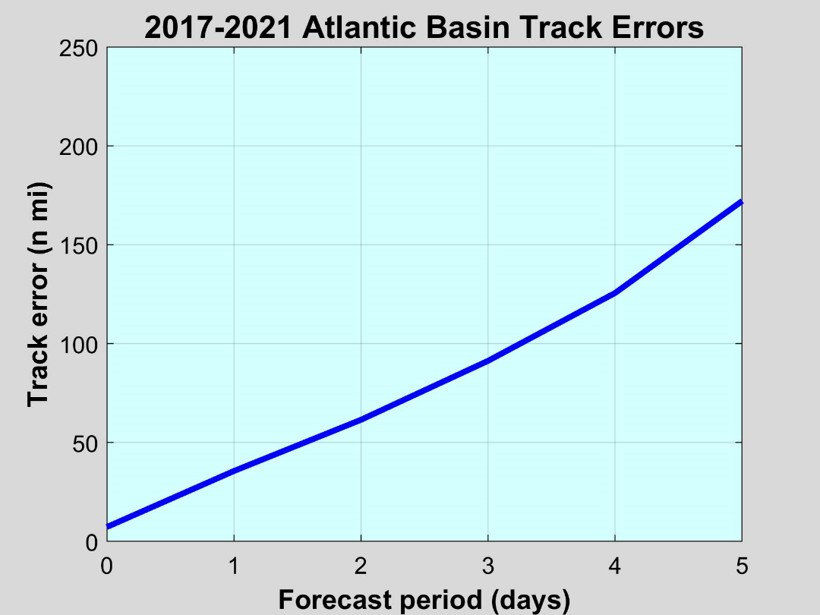
Current Average NHC Track Errors
In general, track errors increase about 30-35 n mi per day.
Track errors are typically larger for weak tropical storms than hurricanes.
Wind speed probabilities can help you account for this uncertainty when making decisions.
172
126
91
62
35

Slide 26
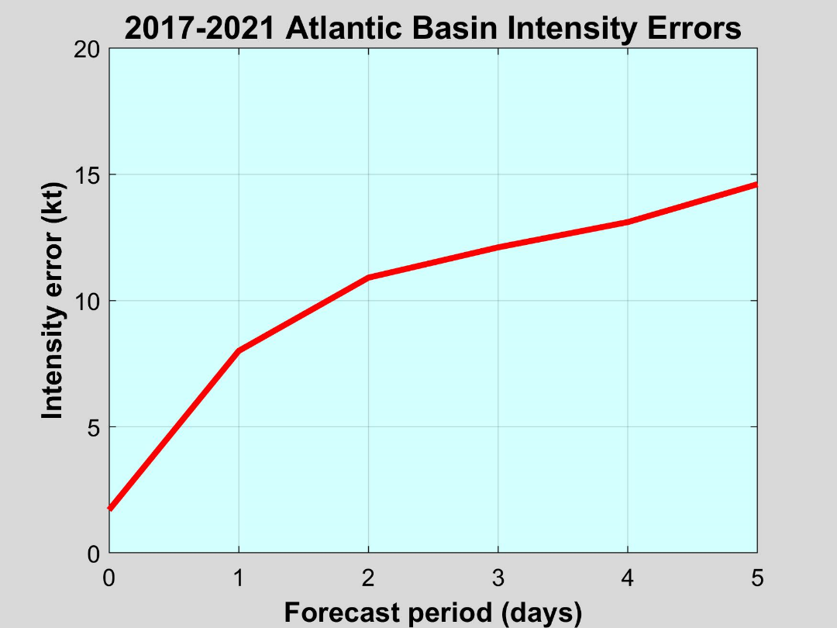
Current Average NHC Intensity Errors
15
Intensity errors increase gradually through the forecast period.
On average, the 24 h and 48 h NHC forecasts are off by about one Saffir-Simpson category.
13
12
11
8

Slide 27
Questions?
hurricanes.gov Email: Brad.Reinhart@noaa.gov

