Slide 1
Rainfall Flooding Impacts
Tropical Storm Eta
Locations of Concern
Greatest threat: SE Florida metro areas
Localized to moderate threat: interior and SW Florida
Timing
Through Tuesday
FLOODING RAIN THREAT
Be Safe and Prepare For These Potential Conditions

Slide 2
Potential Storm Surge Impacts
Tropical Storm Eta
Locations of Concern
Highest threat as depicted above from Biscayne Bay to Coastal Collier County
Timing
East Coast: Late Sunday night and Monday
Gulf Coast: Monday through Tuesday
SURGE THREAT
Be Safe and Prepare For These Potential Conditions

Slide 3
WFO Tropical Product Summary
Be Aware of the Dissemination Caveats for Products
2-7 Days Out
Watch/Warning Phase
Onset & Impact Phase
Hazardous Weather Outlook
Point N Click Forecast Probability Information
Partner Briefings
Hurricane Local Statement (HLS)
Tropical Cyclone VTEC Product (TCV)
Hurricane Threats & Impacts Graphics (HTI)
Marine Weather Warning (MWW)
Short Fuse Watches and Warnings
Observational Reports During and After

Slide 4
Tropical Hazardous Weather Outlook

Slide 5
Port Specific Wind Speed Probability & Timing
Valid 15Z Advisory June 1, 2020
Wind Speed Probability & Timing
Location | Probability of Tropical Storm Force Winds | Tropical Storm Force Winds Arrival Timing | Probability of Hurricane Force Winds | Hurricane Force Winds Arrival Timing
Port of Miami
Port Everglades
Port West Palm Beach
Port of Fort Pierce
Notes:
Optional slide to be used close to landfall to indicate a more narrow window of start and end times.
What are the appropriate time periods for briefing the onset of TS winds?
Greater than 72 hours out: 1-2 day time period
Pre Watch/Warning (48-72 hours): a general day
Taken from the onset probability grids in GFE
Watch Phase: 12 hour onset window
Warning Phase: 6 hour onset window. Use range of wind speeds (not specific deterministic wind).

Slide 6
Port Specific Wind Speed Probability & Timing
Tropical Storm Eta
Wind Speed Probability & Timing
Location | Probability of Tropical Storm Force Winds | Tropical Storm Force Winds Arrival Timing | Probability of Hurricane Force Winds | Hurricane Force Winds Arrival Timing
Port of Miami | 50 | Sunday Mid-Afternoon to Monday Mid-Afternoon | 1 | N/A
Port Everglades | 40 | Sunday Late Afternoon to Monday Early Afternoon | X | N/A
Port West Palm Beach | 30 | Sunday Late Afternoon/Early Evening to Monday Midday | X | N/A
Port of Fort Pierce | 13 | Sunday Early Evening to Monday Midday | X | N/A
IMPORTANT: times on the left is the time frame in which sustained tropical storm force wind is likely to occur for PART of the time, not that it will be continuous for that ENTIRE time.
Gusts/squalls (periodic, short-duration) gusts of tropical storm force are much more likely to occur for most of the depicted time frame.
Notes:
Optional slide to be used close to landfall to indicate a more narrow window of start and end times.
What are the appropriate time periods for briefing the onset of TS winds?
Greater than 72 hours out: 1-2 day time period
Pre Watch/Warning (48-72 hours): a general day
Taken from the onset probability grids in GFE
Watch Phase: 12 hour onset window
Warning Phase: 6 hour onset window. Use range of wind speeds (not specific deterministic wind).

Slide 7
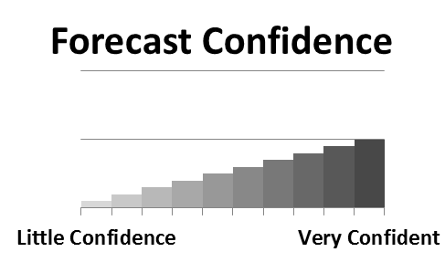
Key Take-Aways
Hurricane
Key Messages
Discussion on Confidence
Notes:
What are the three things you want your audience to take away from this briefing?
For the confidence graphic: choose one arrow, try to be consistent with what is in the NHC discussion or discussed on the hotline calls. In the text, you might discuss confidence on timing, specific impacts or hazards, and break it up if there are extreme differences in what you are confident/not confident about.

Slide 8
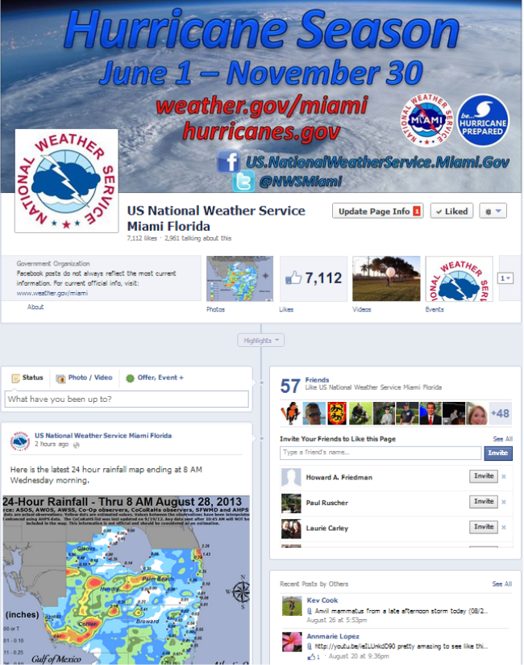
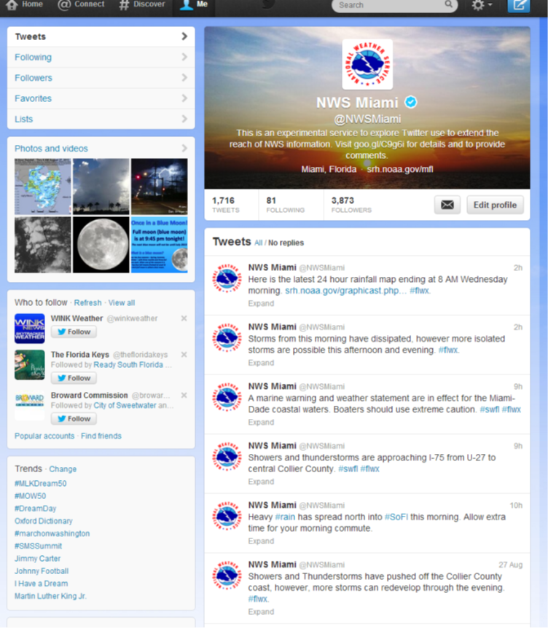
Social Media @NWSMiami

Slide 9
Small Craft Advisory -> Small Craft Warning
Criteria remains the same 20-33kt sustained winds

Slide 10
Questions?
National Weather
Service

Slide 11
