Slide 1
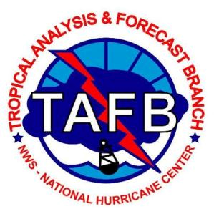
The National Hurricane Center’s Tropical Analysis and Forecasting Branch Weather Support for the USCG
Stephen Konarik
NHC/TAFB Marine Forecaster
USCG/Navy/NOAA Partners Focal Point

Slide 2
NHC Staff & Support
Hurricane Specialist Unit (HSU)
Branch Chief
6 Senior Hurricane Specialists & Warning Coordination Meteorologist
4 Hurricane Specialists
Navy Hurricane Specialist
Technology & Science Branch (TSB)
Branch Chief
Science Operations Officer
6 Meteorologist/Programmers
3 National Centers for Environmental Prediction Central Operations
TSB Project Contractors:
3 Hurricane Forecast Improvement Project Developers
Joint Hurricane Testbed Facilitator
Director’s Office
Director
Deputy Director
Public Affairs Officer
Administrative Officer
2 Administrative Support
Administrative Support Contractor
Librarian
Tropical Analysis & Forecast Branch (TAFB)
Branch Chief
5 Lead Marine Forecasters
6 Marine Forecasters
6 Surface Analysts
Storm Surge Unit (SSU)
Team Lead
3 Storm Surge Specialists
National Oceanic and Atmospheric Administration Corps Officer
5 Storm Surge Support Contractors
World Meteorological Organization Regional Association IV Hurricane Attachments
Visiting Scientists
US Air Force
3 from the Chief, Aerial Roconnaissance Coordination, All Hurricanes Unit (CARCAH)
FEMA
2 Hurricane Liaison Team
Notes:
3 branches

Slide 3
Tropical Analysis & Forecast Branch
Tropical Analysis & Forecast Branch (TAFB)
Branch Chief
5 Lead Marine Forecasters
6 Marine Forecasters
7 Surface Analysts
Pacific Desk
Produce forecast for the Pacific waters east of 140W.
Issue Marine Warnings
High Seas Forecast
Offshore Forecast
Tropical Weather Discussion
-Pacific
Atlantic Desk
Produce forecast for the Gulf of Mexico, Caribbean and N. Tropical Atlantic
Issue Marine Warnings
High Seas Forecast
Offshore Forecast
NAVTEX/VOBRA
Surface Analyst
Unified Surface Analysis
Intermediate weather maps for WPC
Coordinate with OPC, HFO and WPC
Track tropical waves
Tropical Weather Discussion -Atlantic
Surface features: 24, 48, & 72 hr
TAFB Configuration
Pacific Desk
Atlantic Desk
Surface Analyst Desk
Experimental IDSS Desk
Experimental 4th IDSS Desk
Spot Marine Forecast
Provide IDSS briefings to USCG
Assists Dvorak classifications
Social media Twitter/ Briefings
Notes:
IDSS 4th Desk:
This has been our policy (based on 8-hr forecast shifts):
Two or more tropical cyclones (as well as disturbances in the High category of genesis in the 48-hr Tropical Weather Outlook) are forecast to affect the Offshore Waters forecast area of either basin; and/or
Three or more tropical cyclones (as well as disturbances in the High category of genesis in the 48-hr Tropical Weather Outlook) are forecast to affect the High Seas forecast area of either basin.
Both of these criteria assume that the other marine forecaster working the other basin is too busy to assist.
Given the limitations of the 10-hr shift schedule and the teleworking environment, the Leads and i have revised the criteria for invoking the 4th desk sooner than we would normally:
Two or more tropical cyclones (as well as disturbances in the High category of genesis in the 48-hr Tropical Weather Outlook) are forecast to affect the High Seas forecast area of either basin.
If the other basin is quiet, then that marine forecaster can assist the forecaster with the busy tropical cyclone activity and the 4th desk does not need to be invoked.
For the hours to be worked, we will have the 4th desk staffed generally from 23-09Z (7pm-5am) and 11-21Z. (7am-5pm) for the Night and Day 4th desk. If not needed for the entire 10 hours, then the forecaster would be able to spend the remaining time doing admin work.

Slide 4
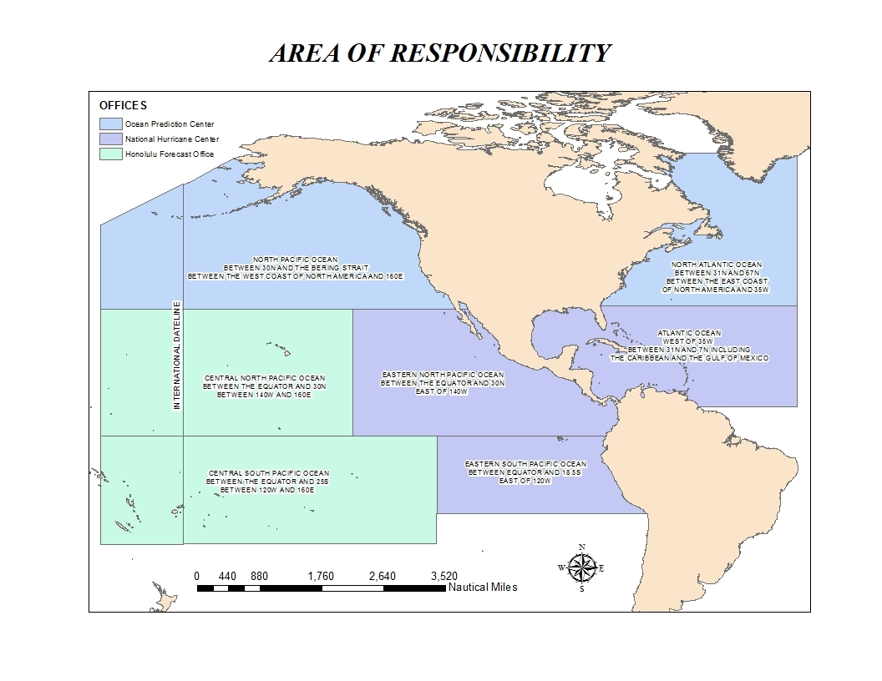
TAFB Area of Responsibility
Ocean Prediction Center
NHC / TAFB
Honolulu WFO

Slide 5
USCG/NOAA Memorandum of Agreement
Interagency coordination to support our common goals
“NOAA/NWS agrees to provide USCG units with weather information necessary for the safe and successful accomplishment of their assigned missions.”
Interagency coordination through “meteorological forecasts and warnings provided by the NOAA/NWS in support of USCG missions.”
“…Specific forecasts (i.e., Spot Forecasts) and briefings may be provided for extraordinary events…”

Slide 6
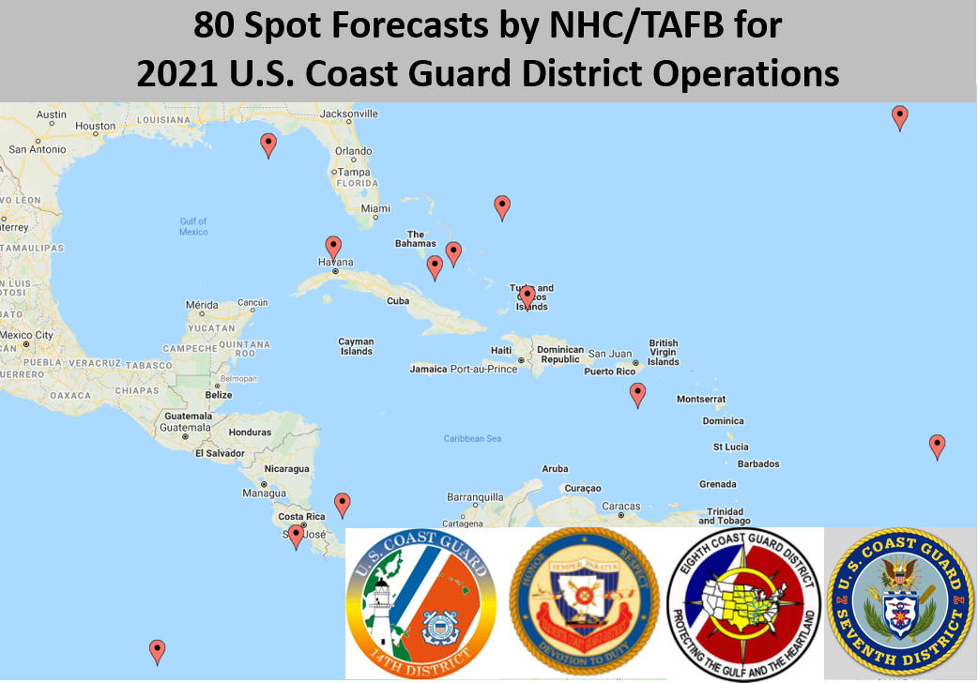
Spot Forecasts
On-demand, site-specific weather forecasts issued by the National Weather Service in support of incident management decisions
The National Hurricane Center can issue spot forecasts to support USCG response to marine incidents or search and rescue operations
We provide spot forecasts for our Offshore Waters and High Seas
2019: 54
2020: 37
2021: 73

Slide 7
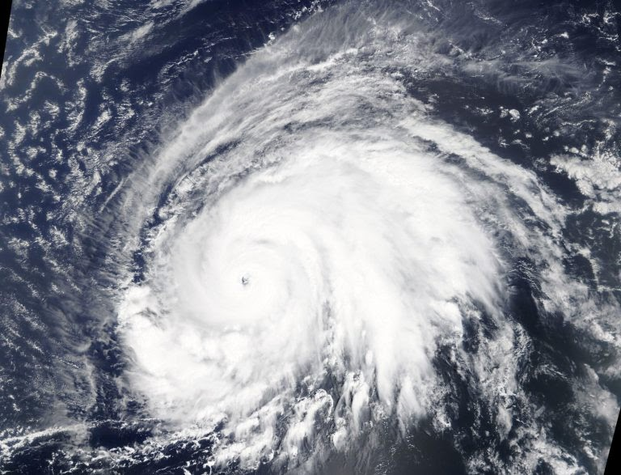
Example: Bourbon Rhode Sinking
Hurricane Lorenzo (2019)
We provided 35 spot forecasts for the Bourbon Rhode SAR and recovery efforts from Sep 26-Oct 5, 2019

Slide 8
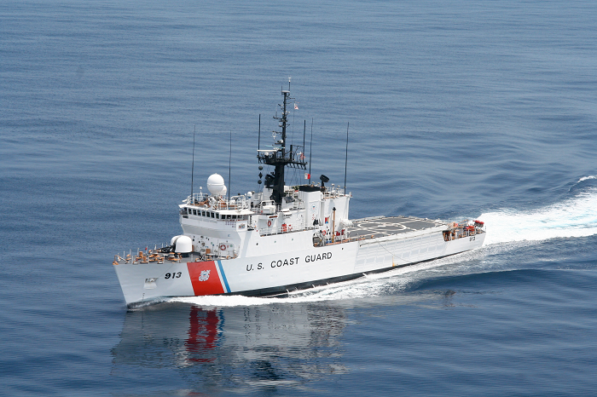
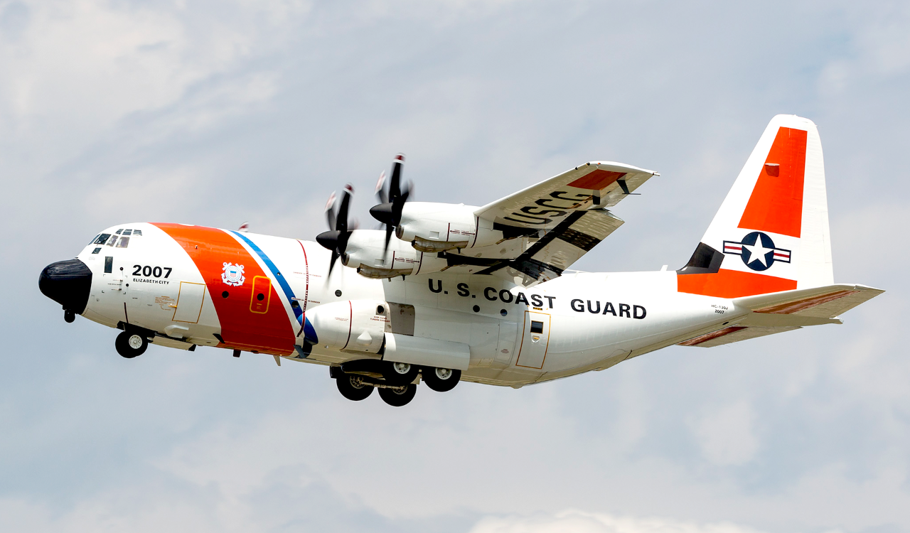
Spot Forecast Content
What marine weather information can we provide?
Marine Weather
Surface wind/gust (kt)
Significant wave height (ft)
Swell height
Wind wave height
Dominant wave period (s)
Sea surface temperature (°F)
Sky coverage/weather
Max/min temperature (°F)
Dew point (°F)
Humidity
Do you need aviation forecast support?
Let us know, and we can pass along the incident details and your contact information to the NOAA Aviation Weather Center for further assistance.

Slide 9
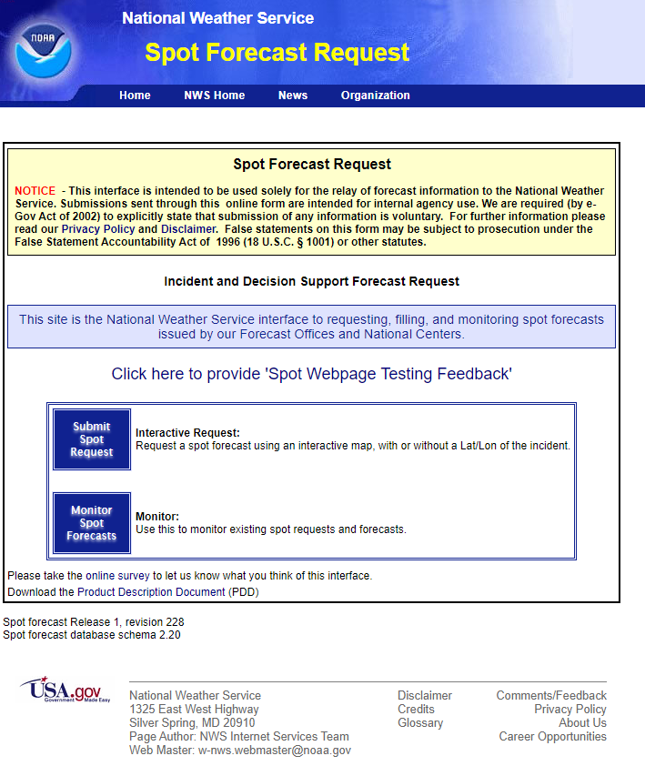
Requesting Spot Forecasts
How do you submit a direct forecast request?
You can directly submit spot forecast requests to us: https://www.weather.gov/spot/request/
We will share step-by-step instructions on how to use the web request interface
If further assistance is needed for a marine incident, feel free to call our 24/7/365 forecast operations:
305-229-4424

Slide 10
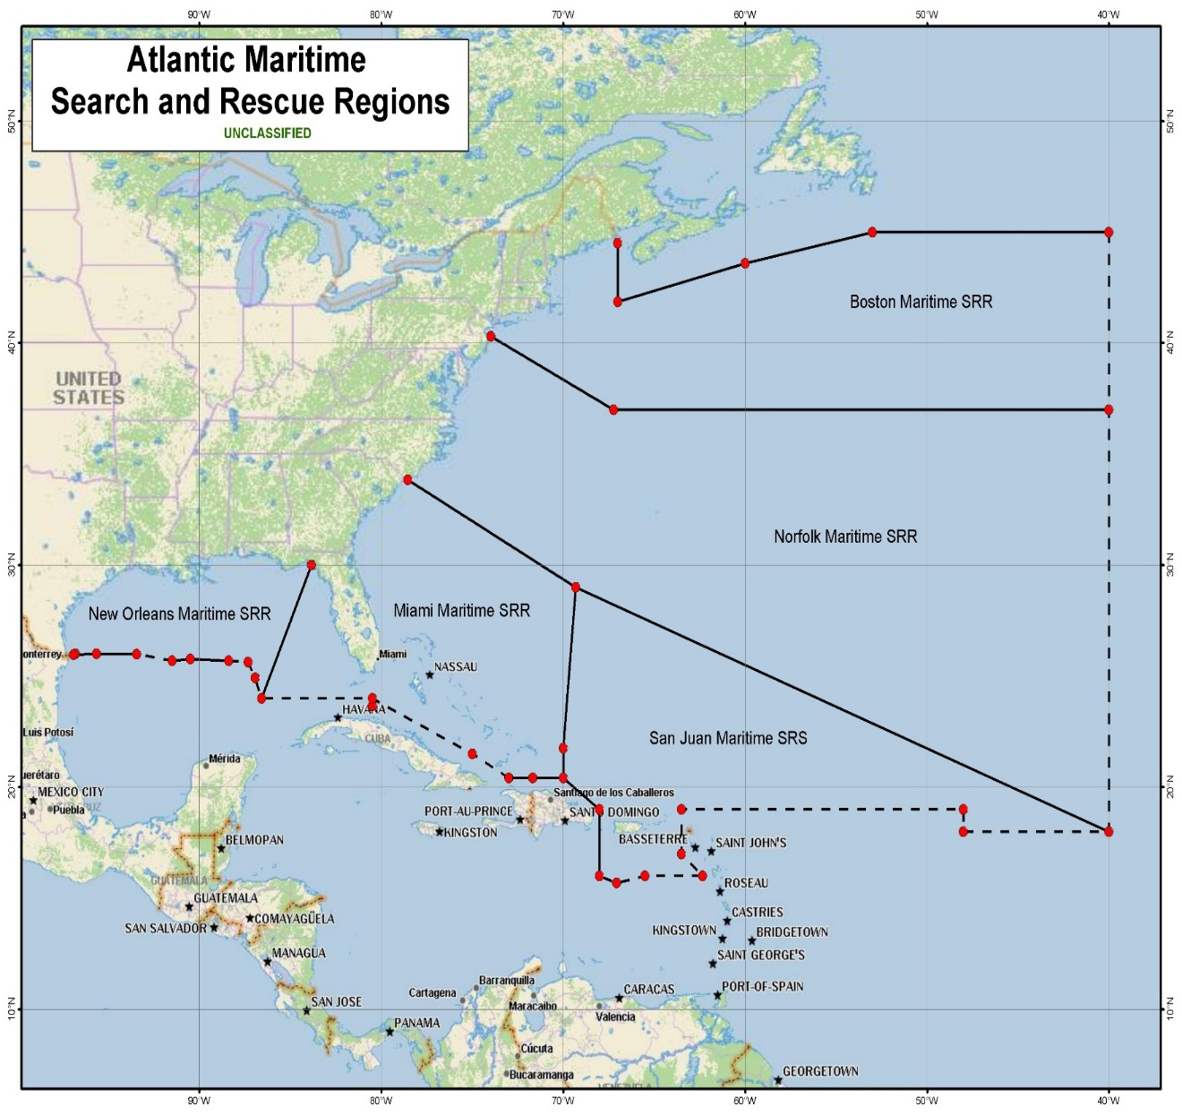
Tropical Briefings
TYPICALLY ISSUED WHEN
Tropical Storm force winds may be impacting coastline within 5 days
Hurricane conditions in Search and Rescue Area (SAR) within 5 days
2019 briefings: 42
2020 briefings: 82
2021 briefings: 44
BRIEFING GOALS
Potential impacts to mariners over the Gulf of Mexico, Caribbean Sea, and Atlantic in their SR
Potential impacts to major ports in the United States
Potential impacts to USCG District 7 facilities and personnel
Potential impacts to other countries in the Caribbean that may need USCG assistance.
D7/Miami:
Winter Storm (1 briefing)
Trop. Storm DANNY (1)
Hurricane ELSA (13)
Tropical Storm FRED (9)
Tropical Storm MINDY (1)
D8/New Orleans:
Trop. Storm ANA (1 briefing)
Trop. Storm CLAUDETTE (3)
Trop. Storm FRED (1)
Hurricane IDA (9)
Trop. Storm NICHOLAS (5)

Slide 11
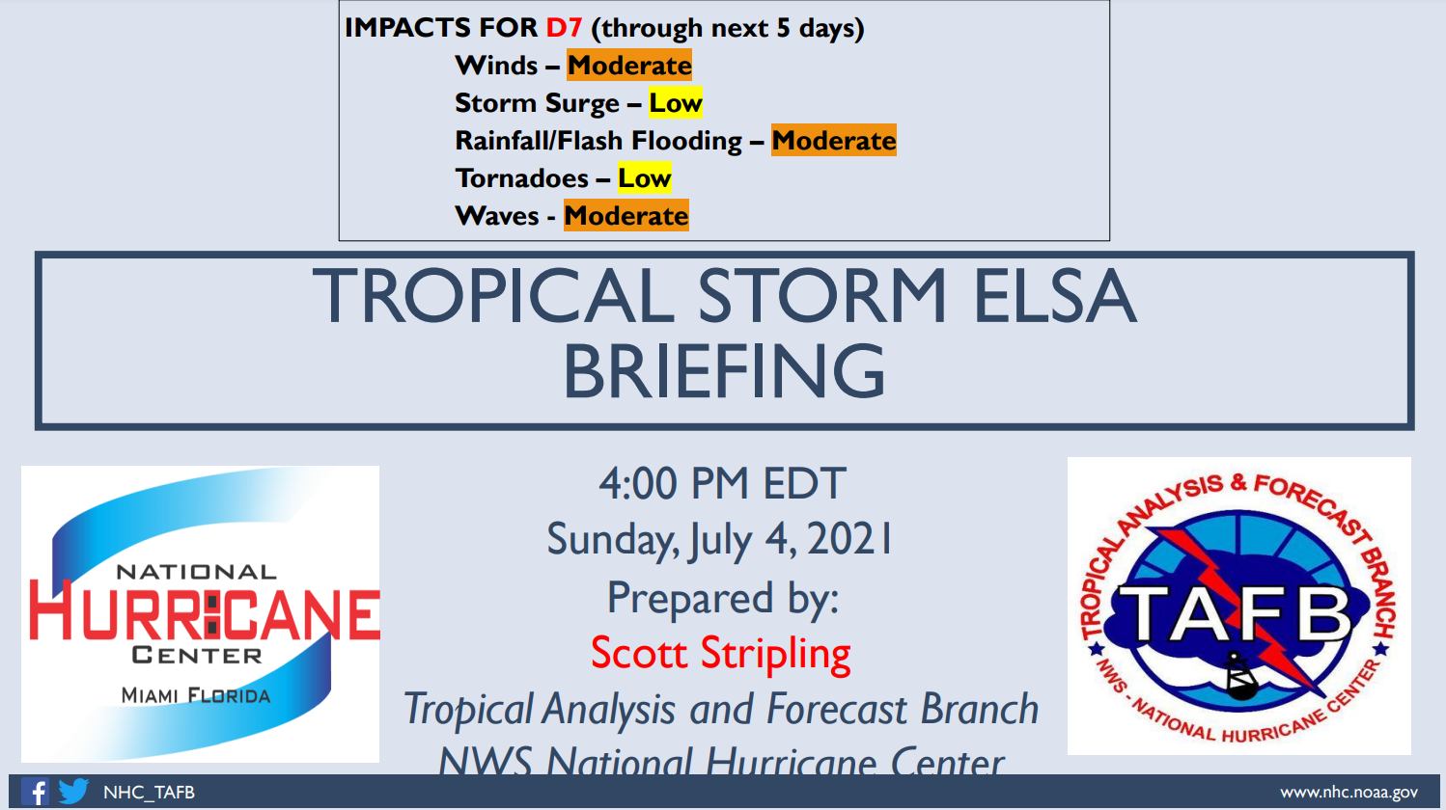
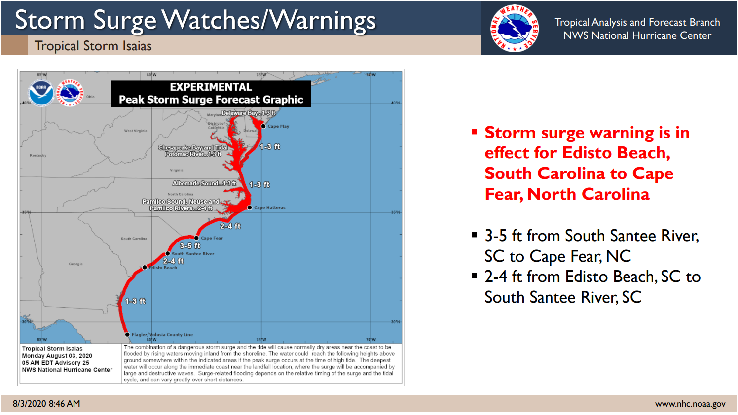
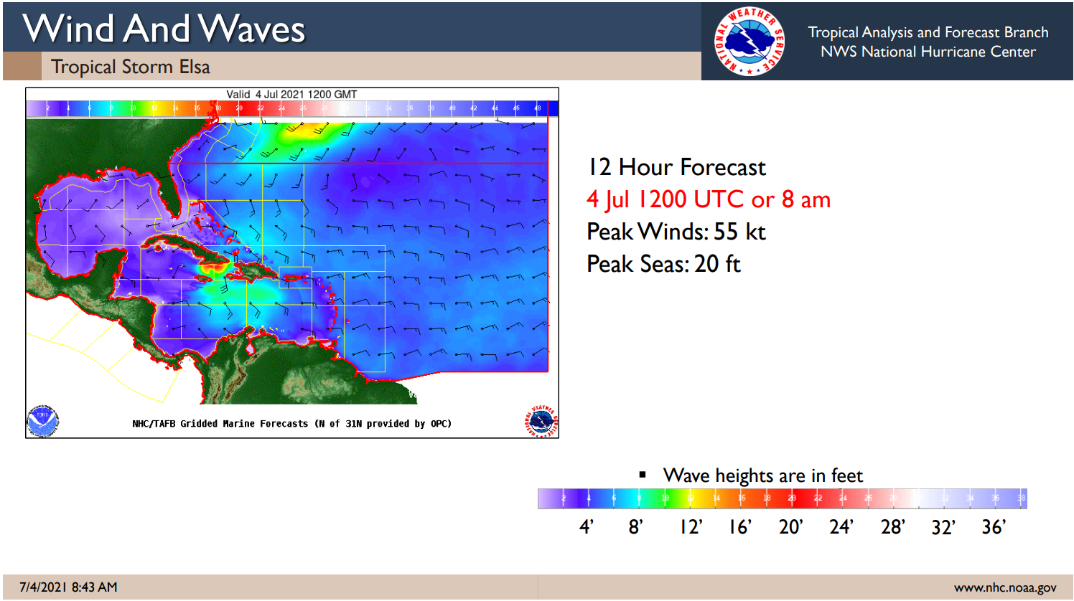
Tropical Briefings
Provide tailored information for
Wind Hazards, including time of arrival and departure
Rainfall/inland flooding potential
Storm Surge Information
Wave heights
Tornadoes

Slide 12
Example of Tropical Briefing

Slide 13
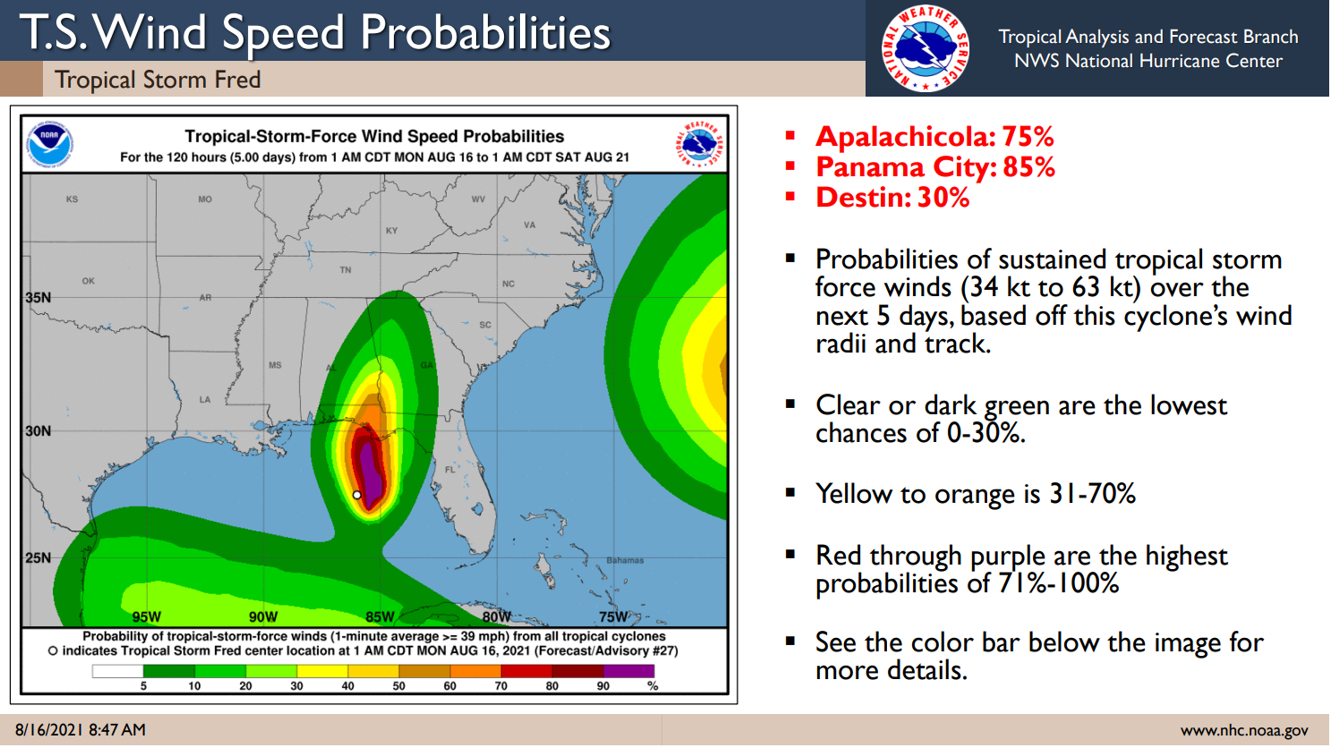
Example of Tropical Briefing

Slide 14
Example of Tropical Briefing

Slide 15
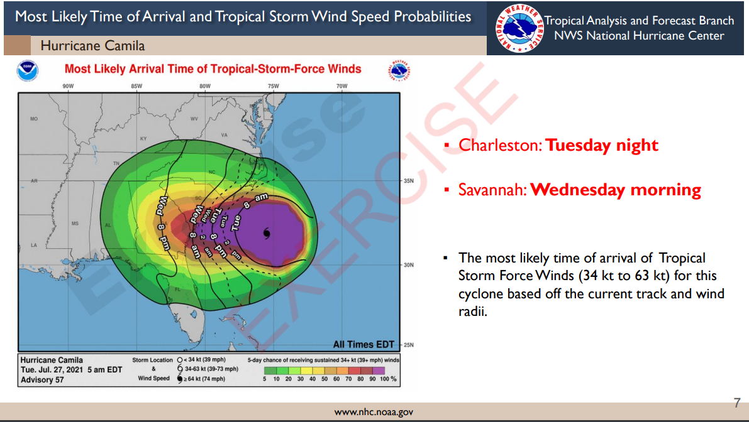
Example of Tropical Briefing

